Slide 1


Introduction to Web Scraping with Python
Web scraping automates extracting data from websites efficiently.
Python, Requests, and Beautiful Soup simplify this process greatly.
by Nitish Galat

Slide 2

Why Web Scraping?
Data-driven Decisions
Supports marketing, finance, and research by providing actionable data.
Competitive Analysis
Monitor pricing and features of competitor products in real-time.
Content Aggregation
Collects news, job listings, and real estate data for easy consumption.
Academic Research
Gathers large datasets for analysis and study purposes.

Slide 3

Python for Web Scraping
Simple Syntax
Easy-to-learn language with clear, concise code.
Extensive Libraries
Rich ecosystem including Requests, Beautiful Soup, and Scrapy.
Community Support
Vast resources and tutorials for beginners and experts.
Focus Libraries
Requests handles web access; Beautiful Soup parses HTML.

Slide 4
Requests Library
HTTP Methods
Features
GET to retrieve data
Manage headers, cookies, sessions
POST to send data
Handle response status (200 OK, 404 Not Found)
PUT and DELETE for updates
Simple syntax example: requests.get()

Slide 5

Beautiful Soup Library
Parse HTML/XML
Transforms raw source code into navigable structure
DOM Navigation
Locate elements by tag, class, or ID efficiently
Data Extraction
Pull text, attributes, and URLs cleanly from pages

Slide 6
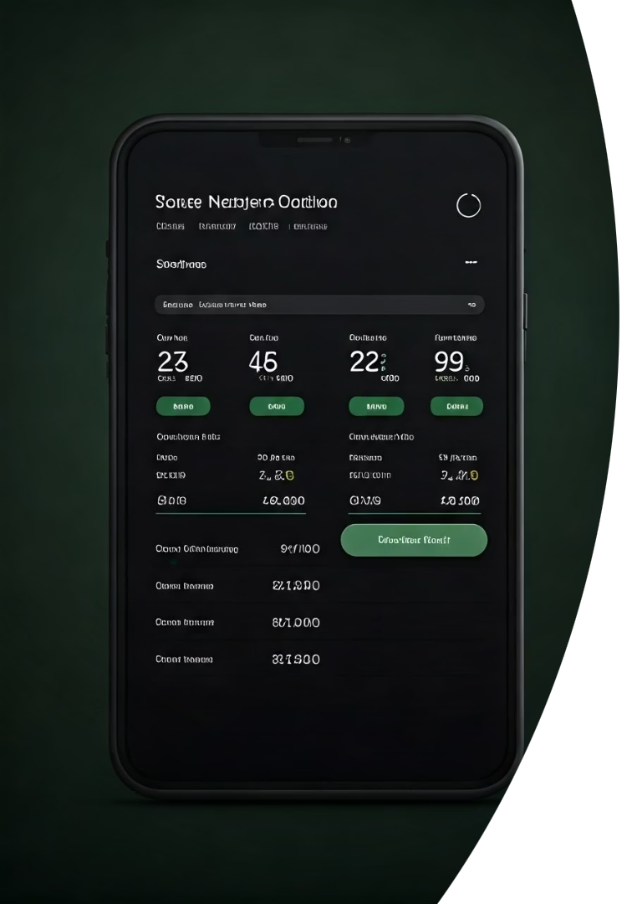



Real-Life Use Cases: E-commerce
Price Monitoring
Product Information
Customer Reviews
Track competitor prices daily for strategy adjustments
Extract details and images for catalog updates
Analyze sentiments to improve product offerings

Slide 7
Real-Life Use Cases: Finance and News
Financial Data
News Aggregation
Gather stock prices and economic indicators easily
Collect articles from various sources for overview and analysis

Slide 8

Ethical Considerations and Best Practices
Respect `robots.txt`
Server Load Control
Follow site scraping rules and restrict access accordingly
Use delays and caching to prevent overload
Legal Compliance
Adhere to terms of service and data privacy laws like GDPR

